Slide 1
Shopping Cart and Donation System
Group 2

Slide 3
Iterations

Slide 4
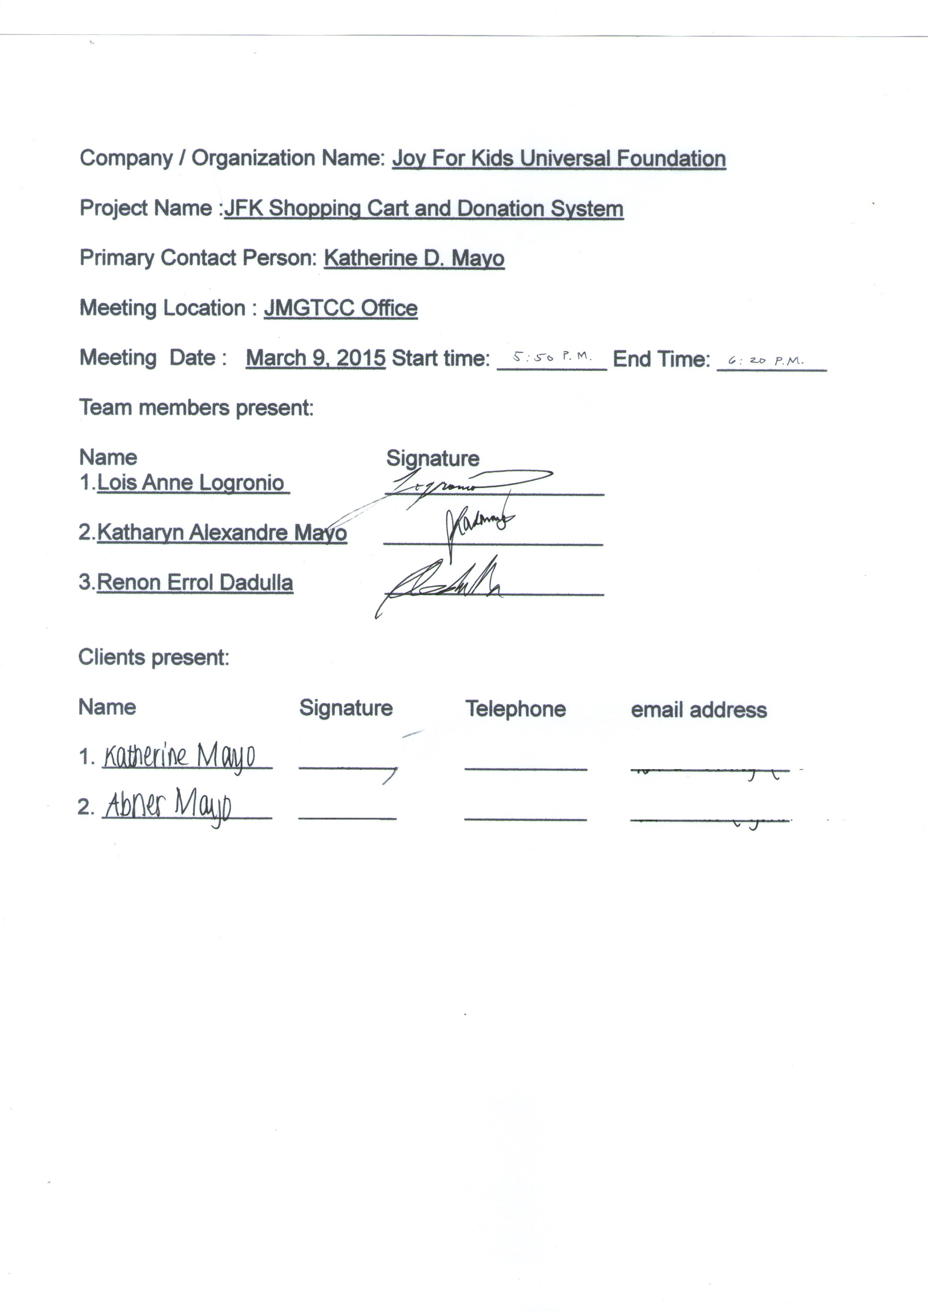
Iteration 1

Slide 5
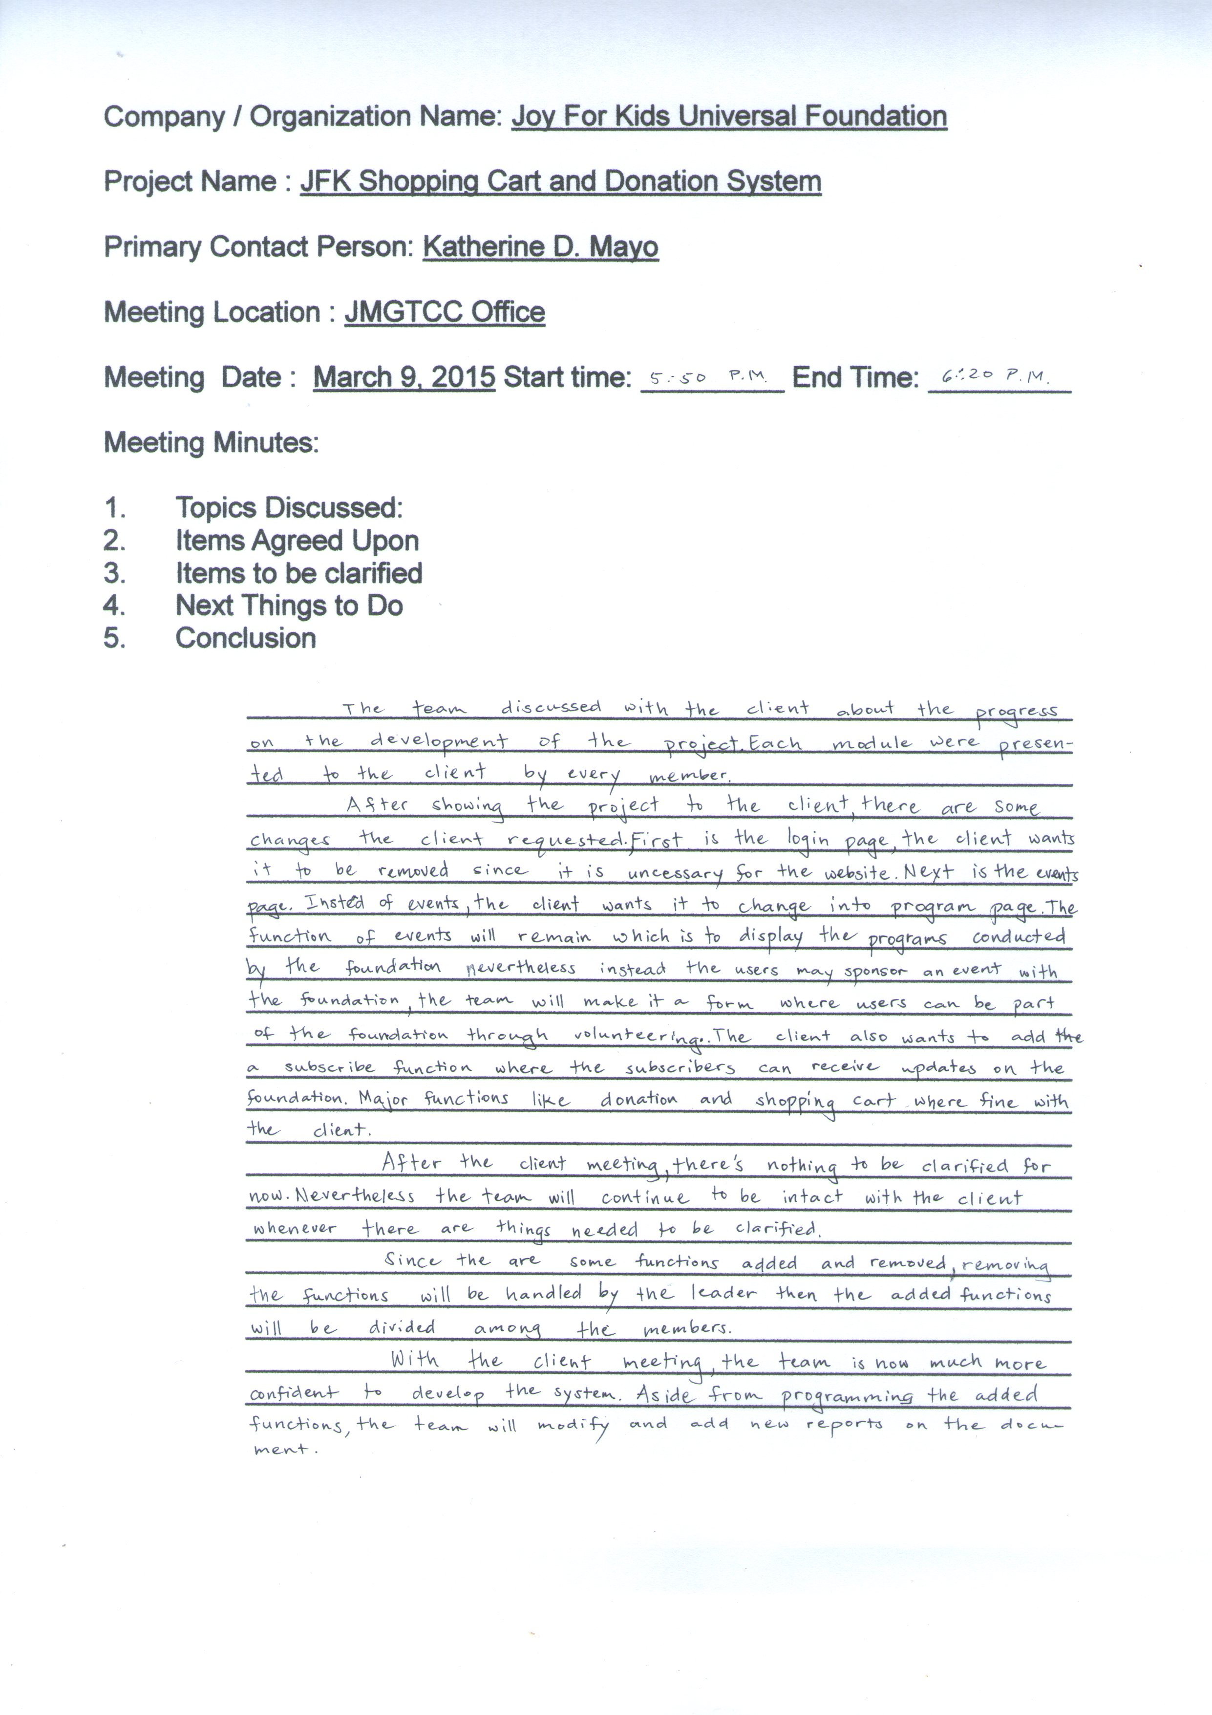

Slide 6
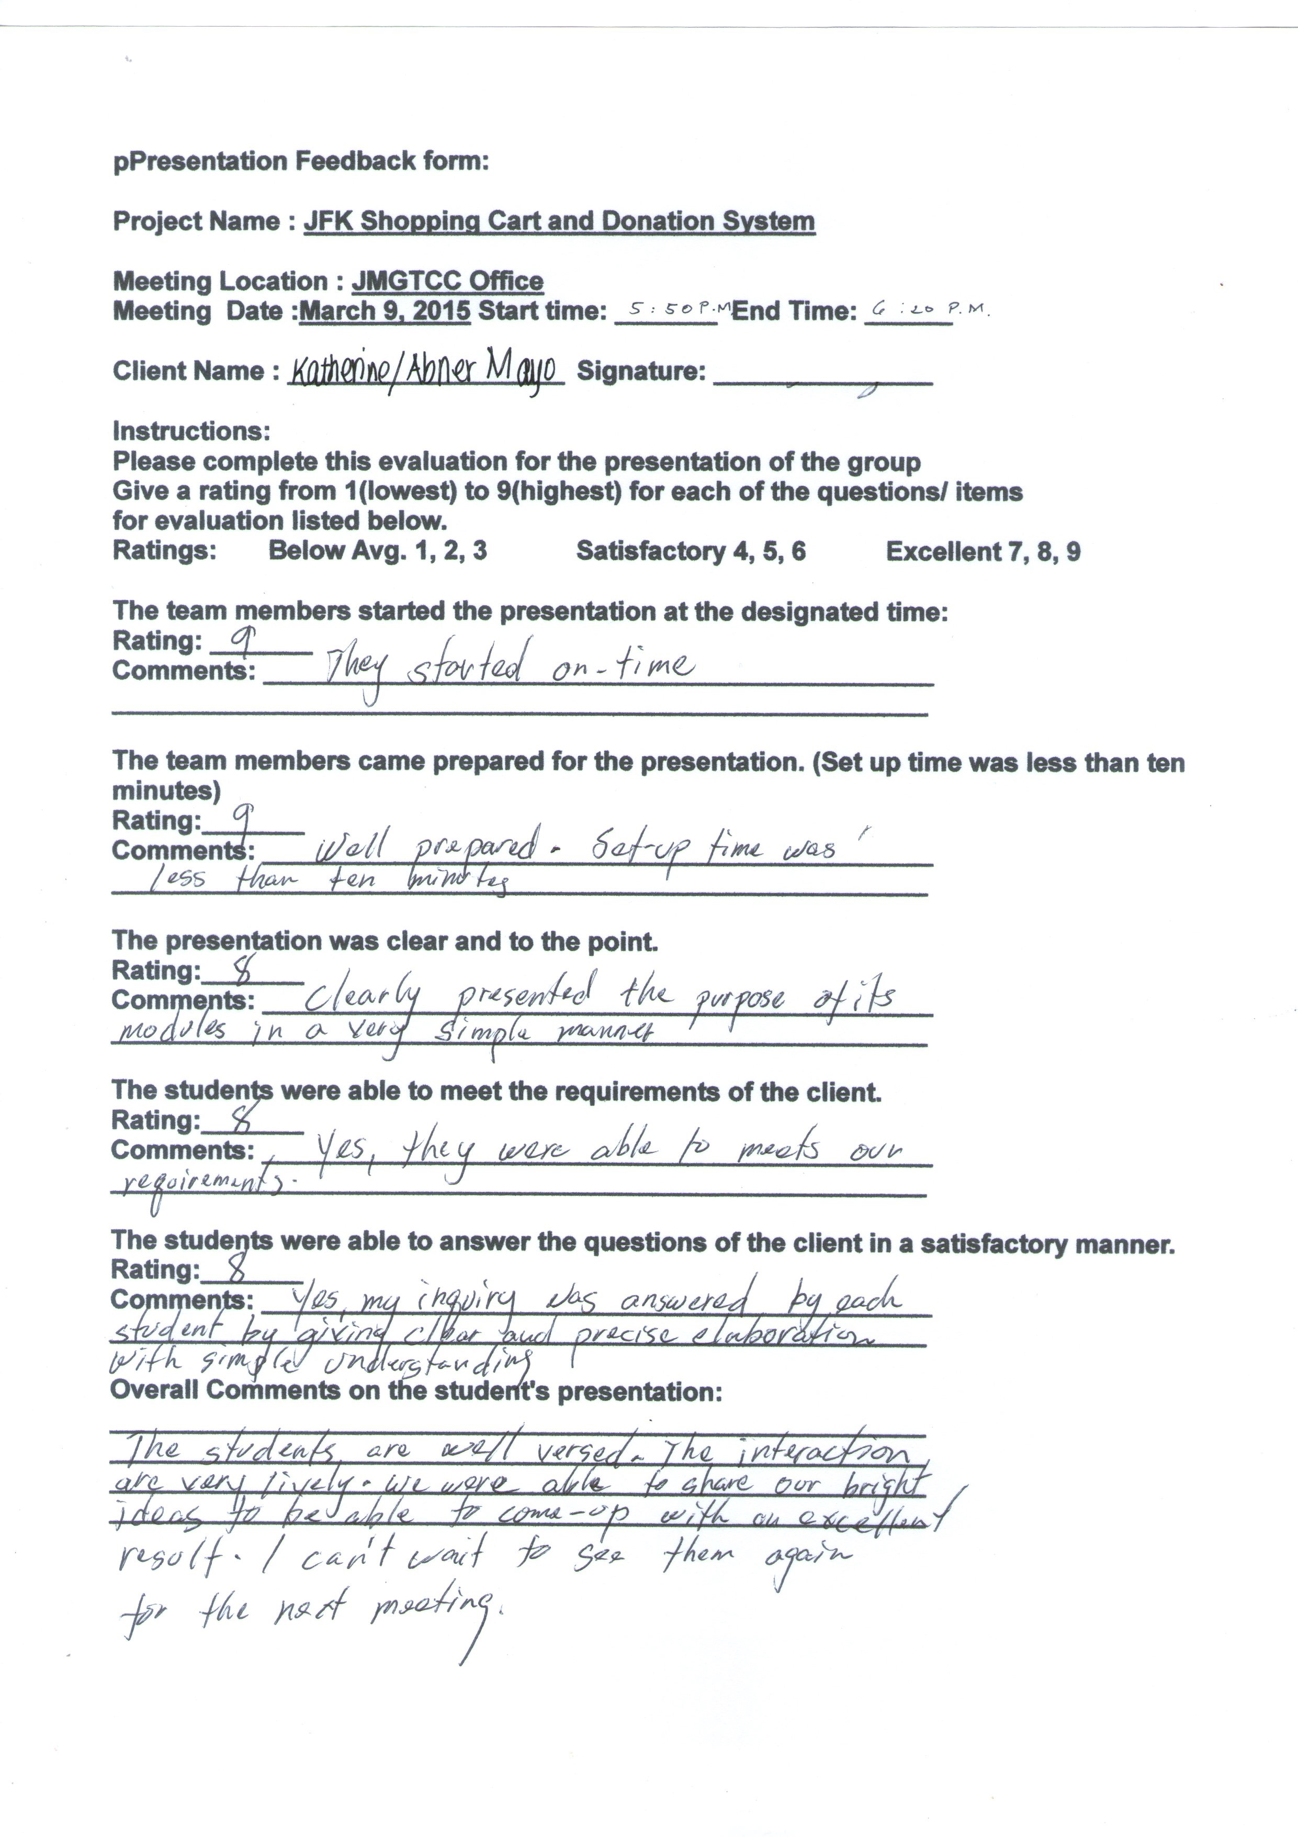

Slide 7
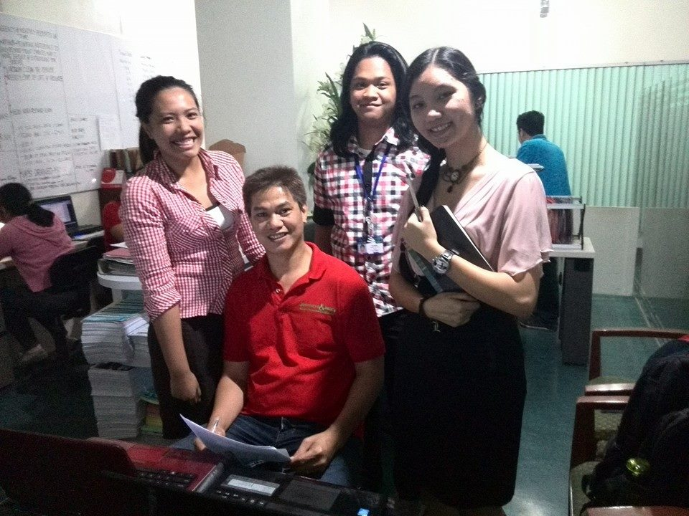

Slide 8
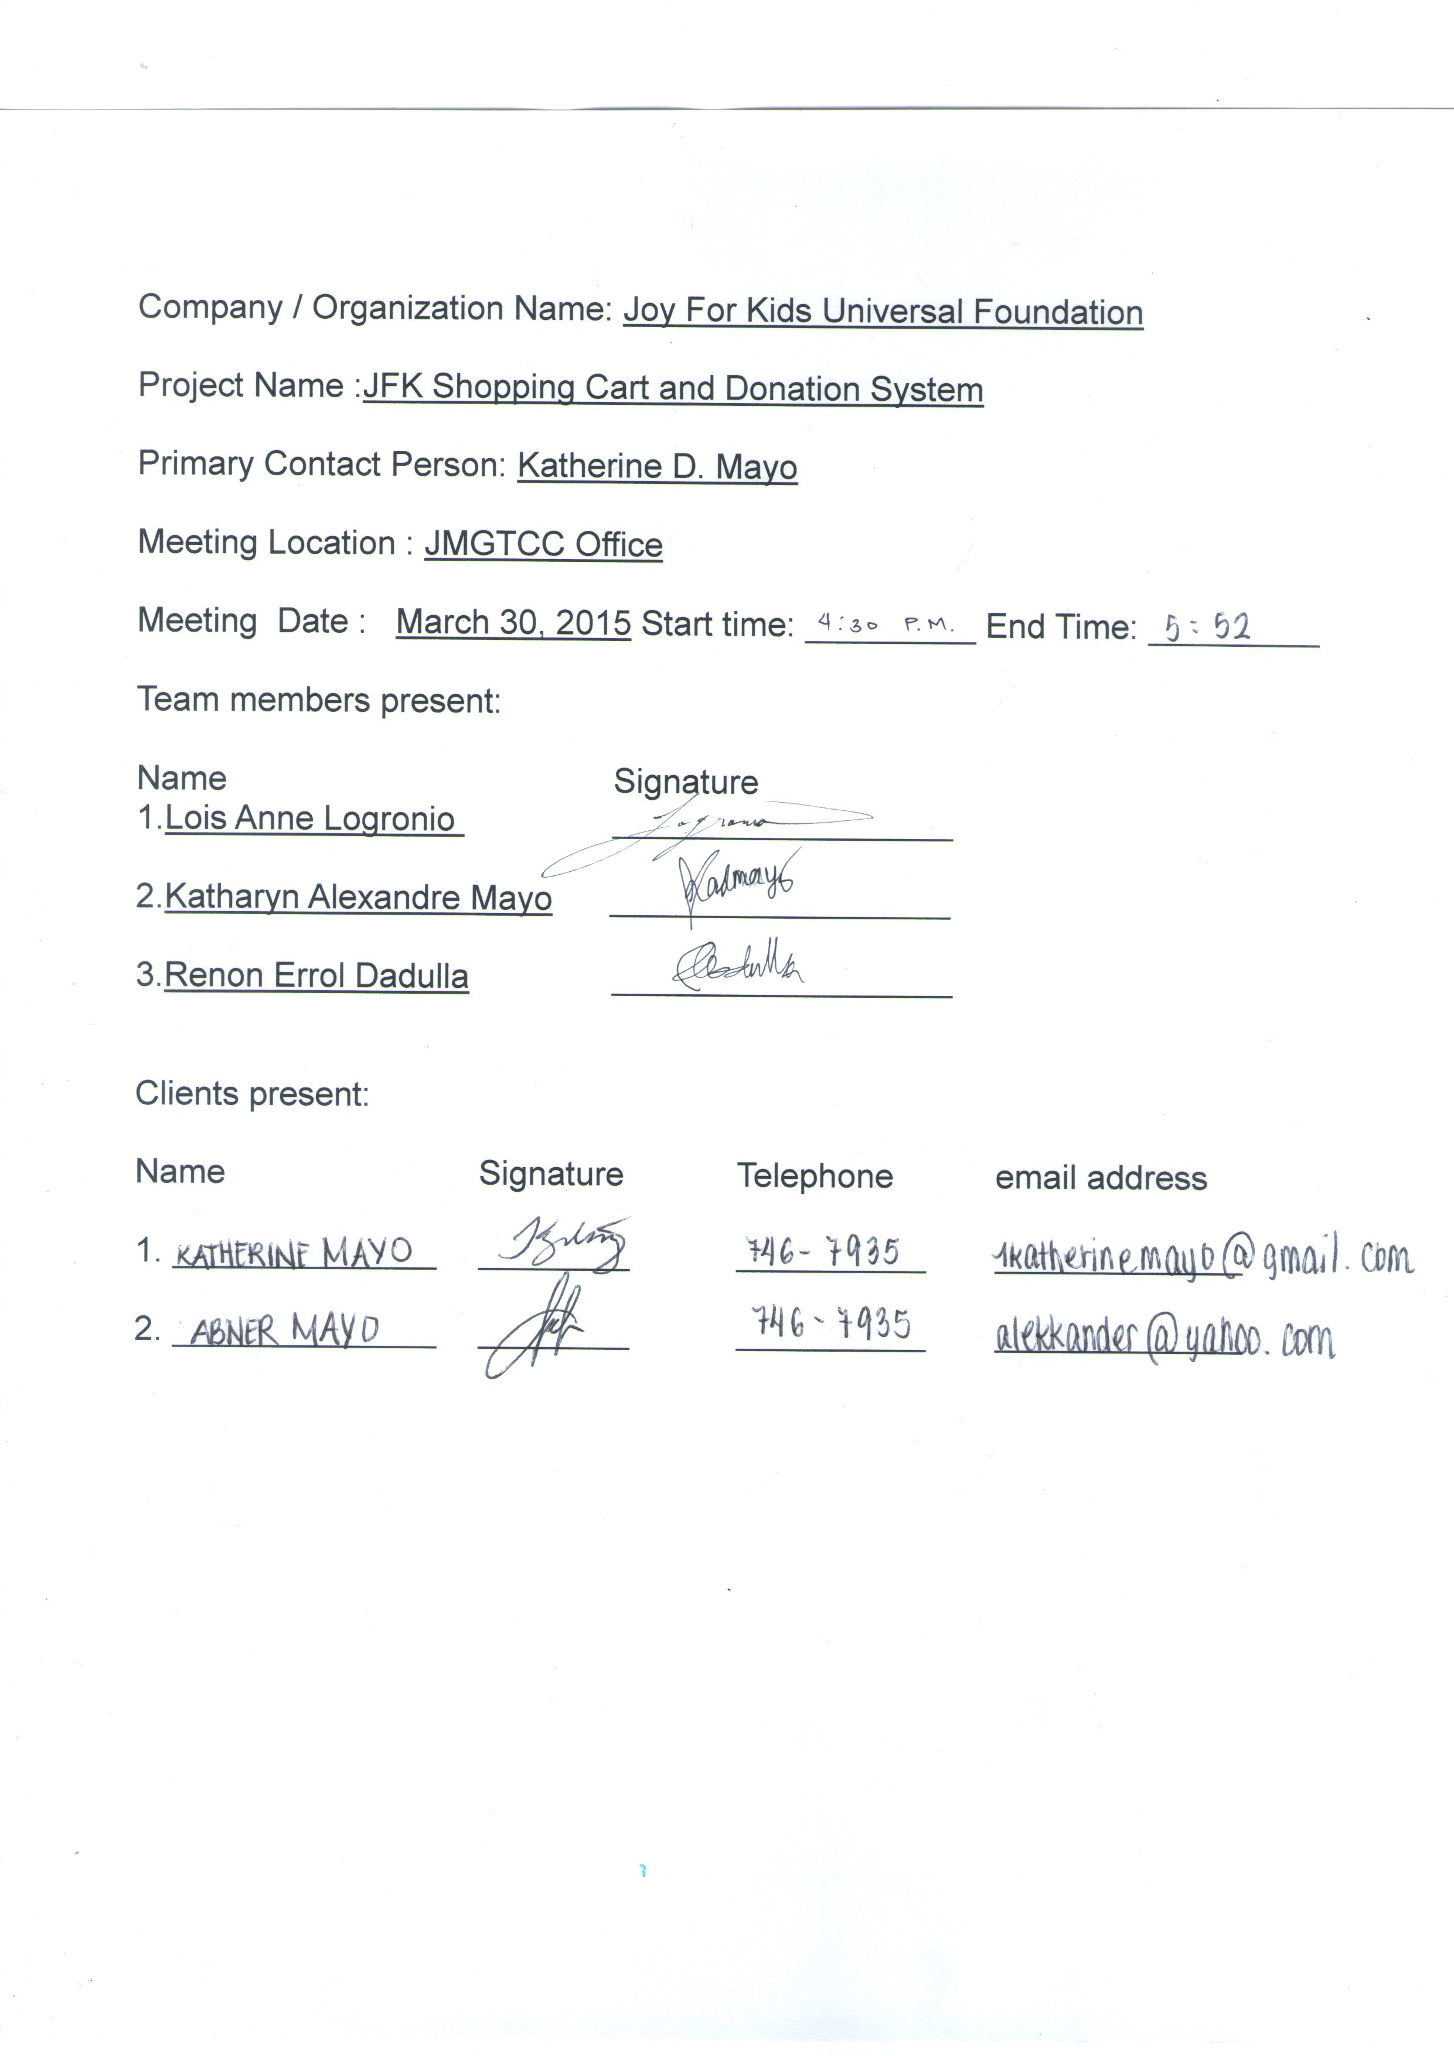
Iteration 2

Slide 9
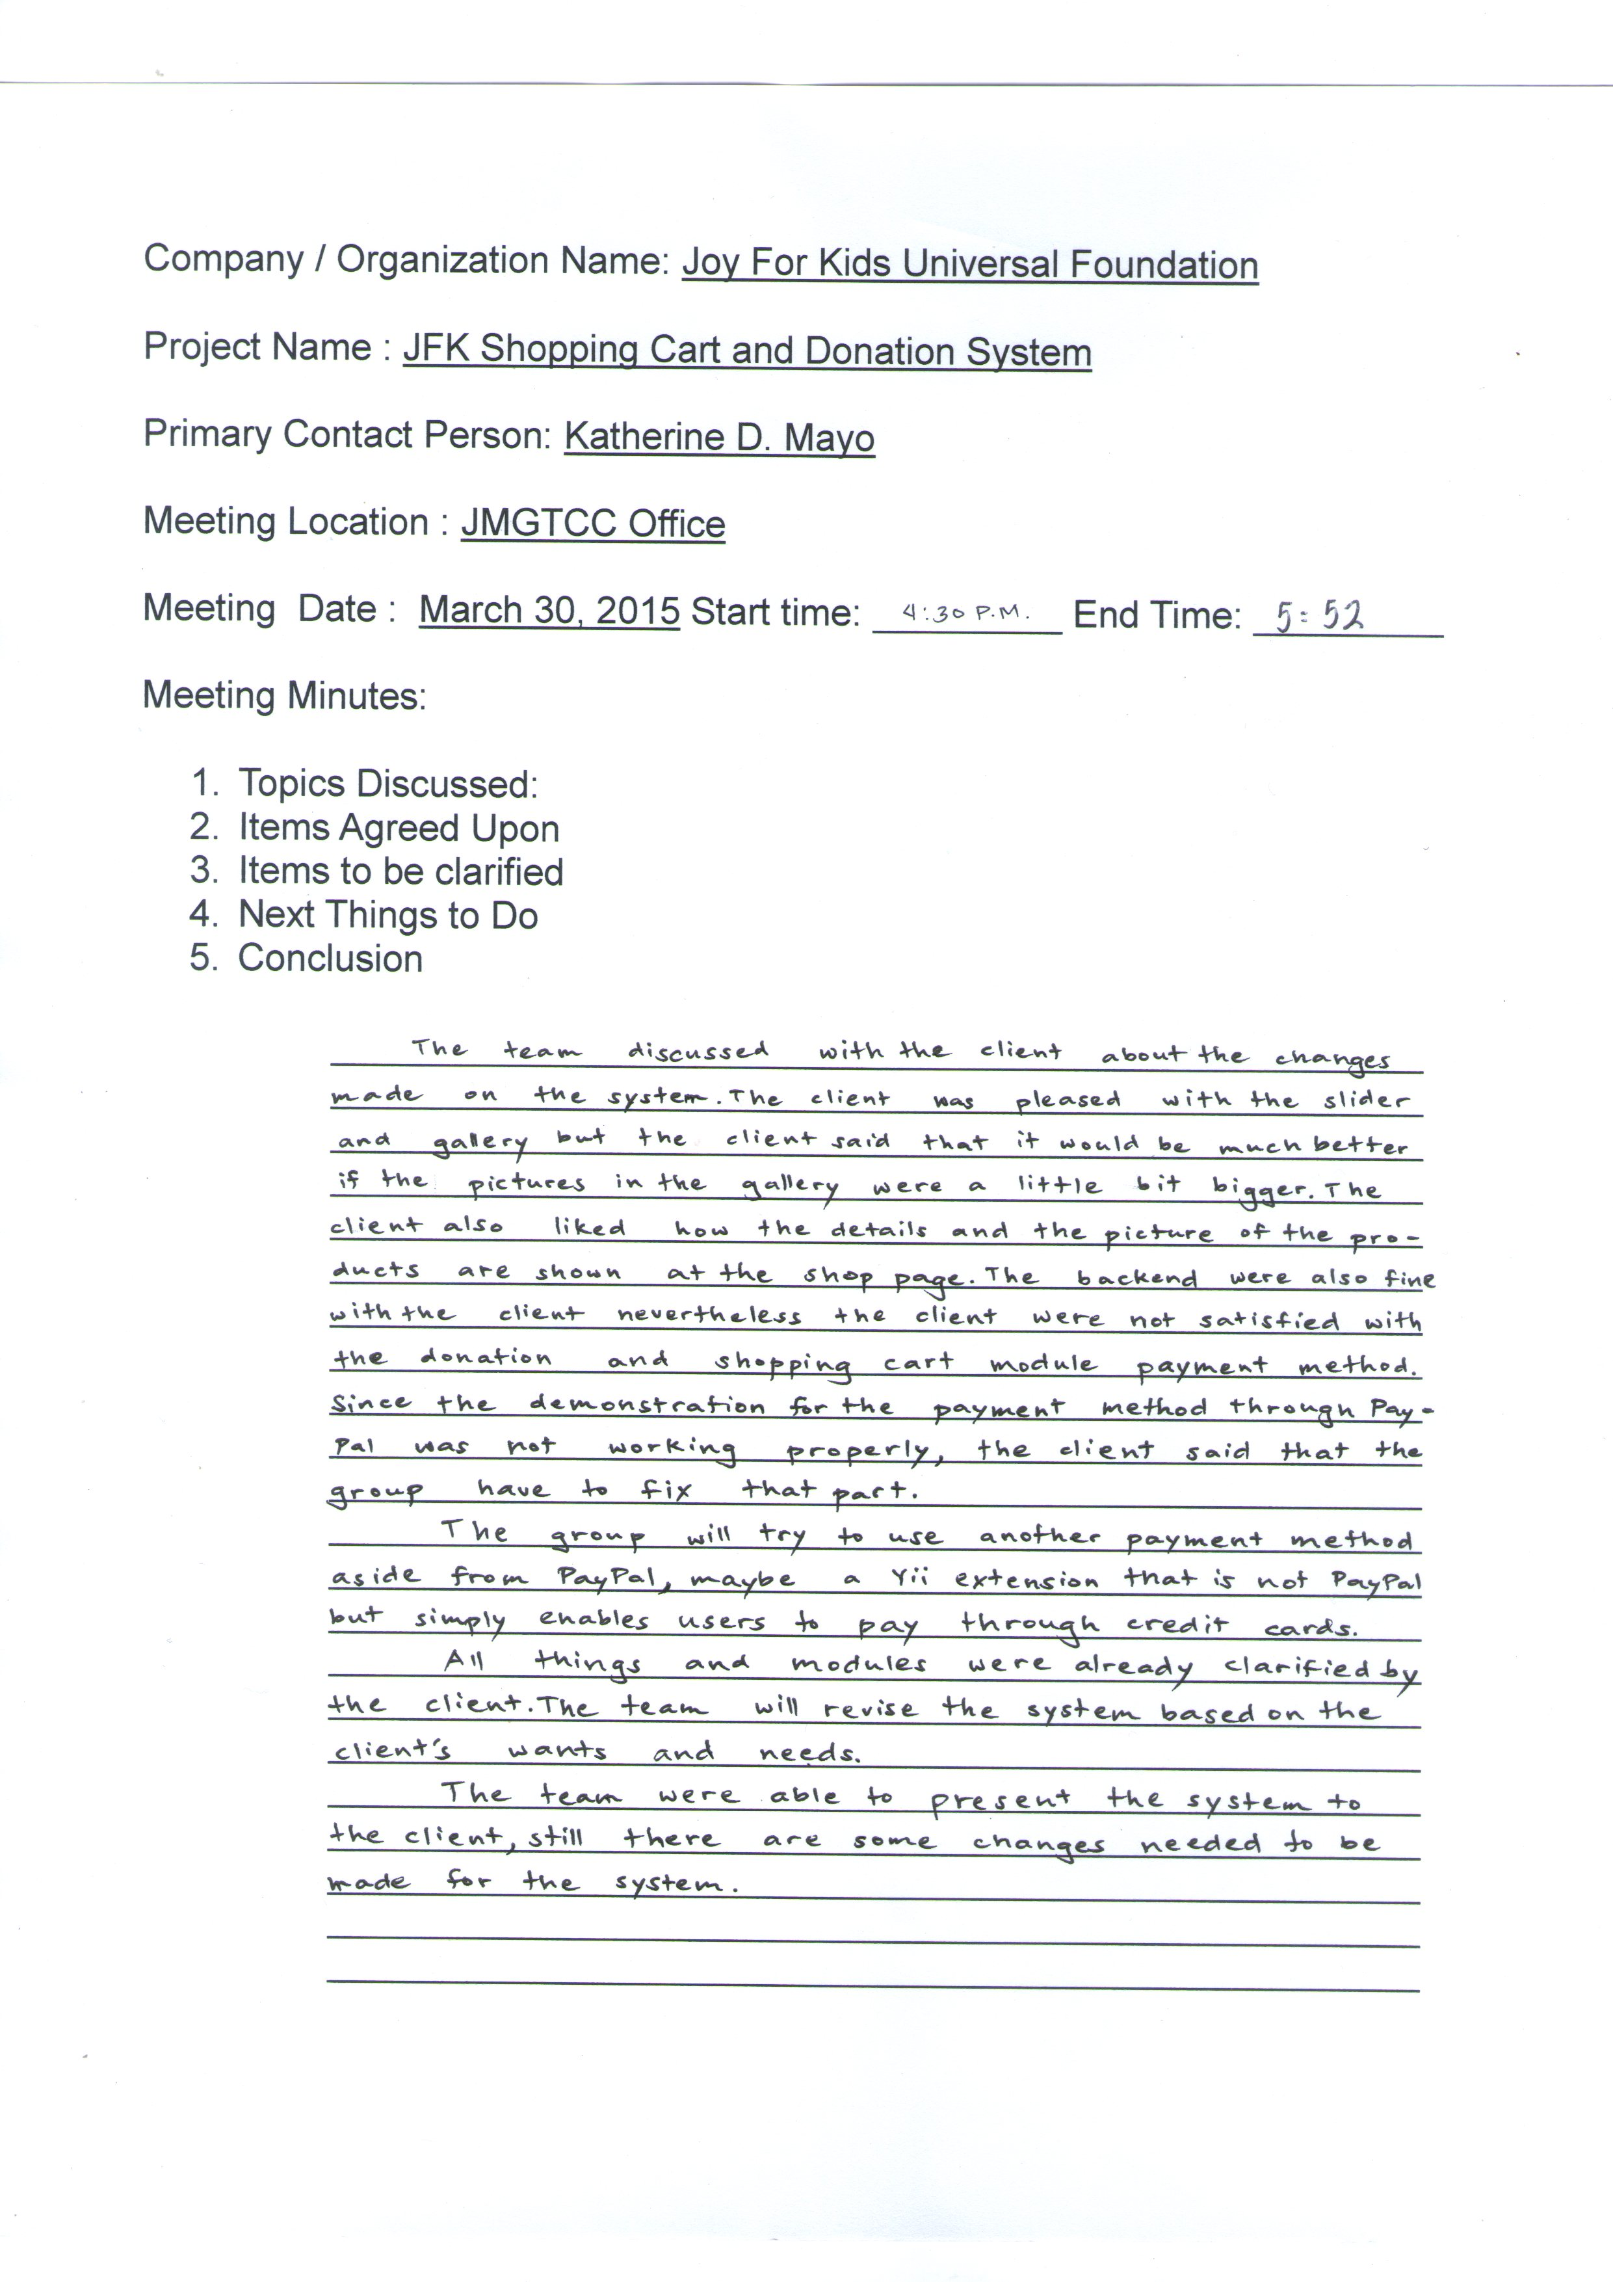

Slide 10
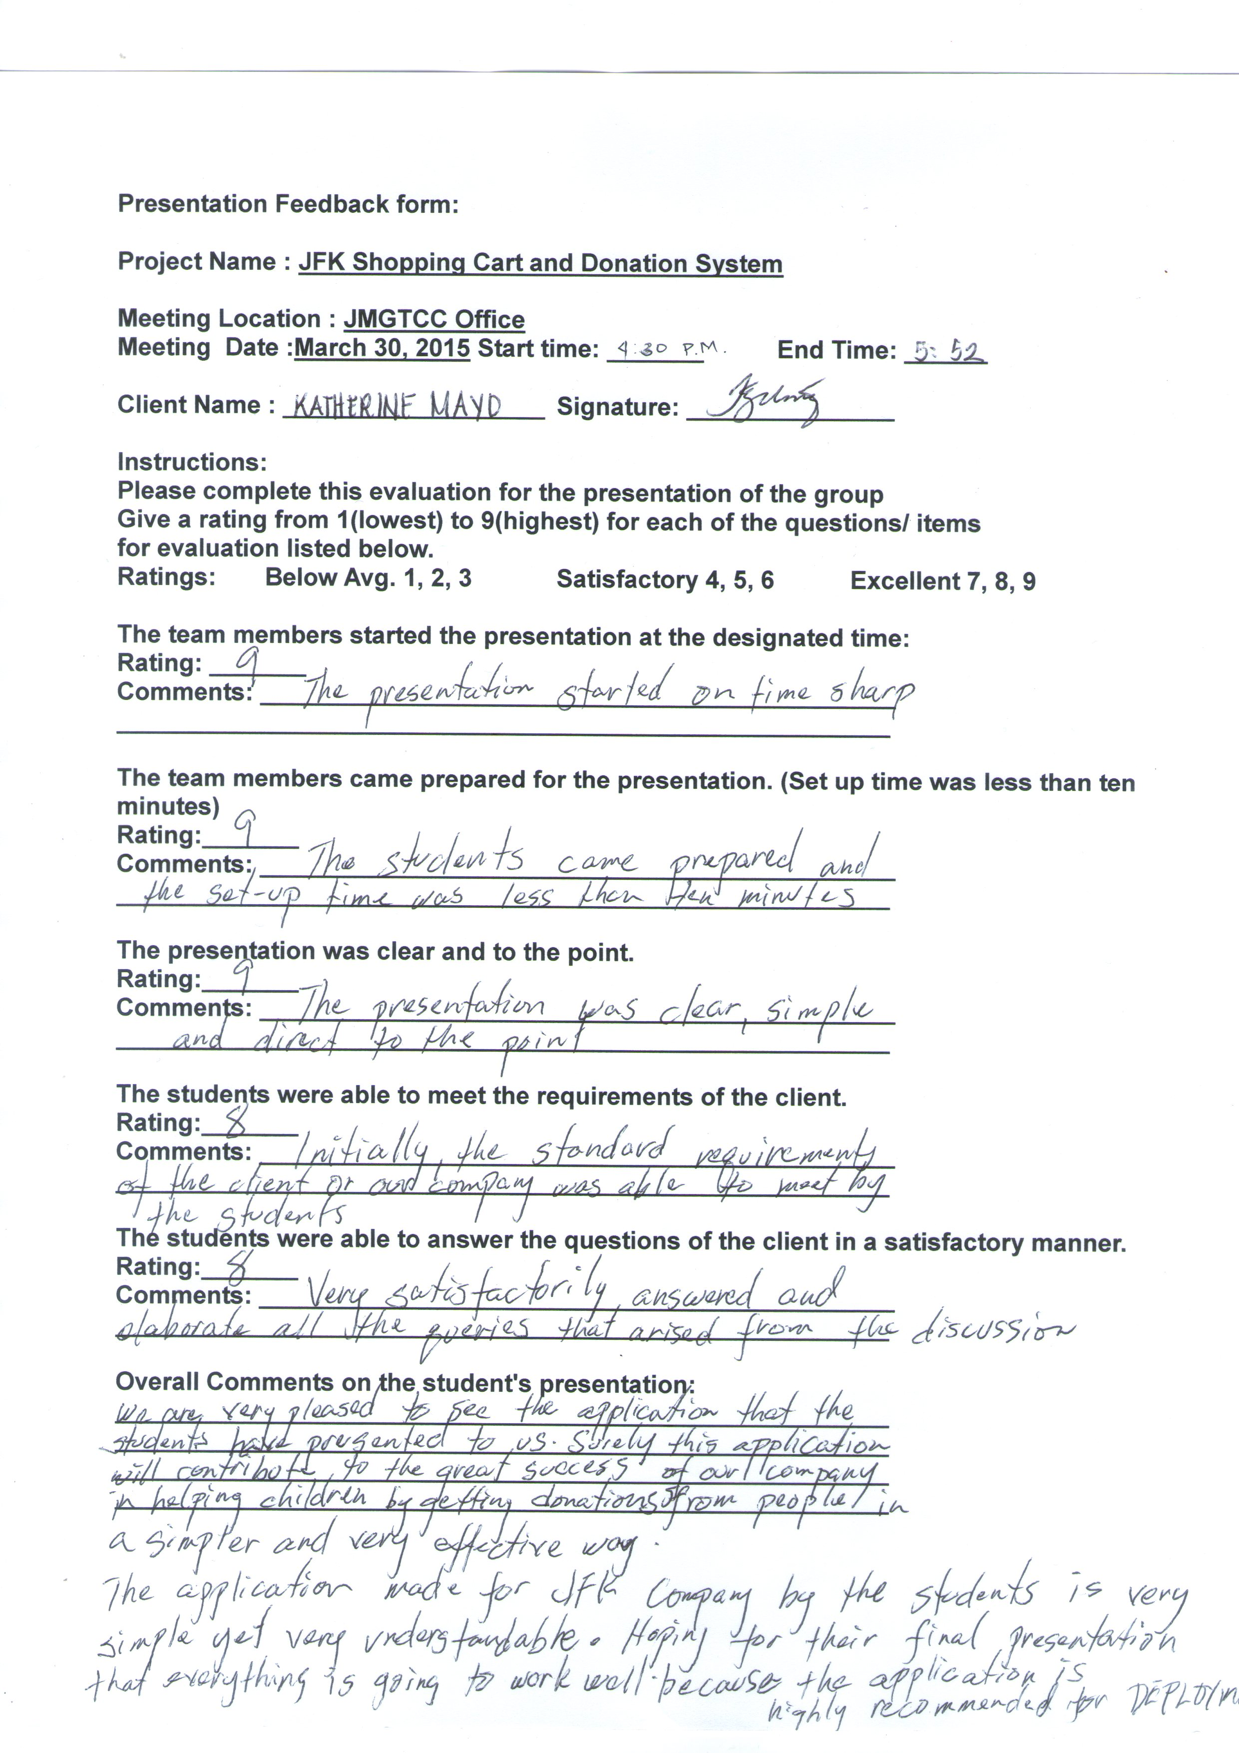

Slide 11
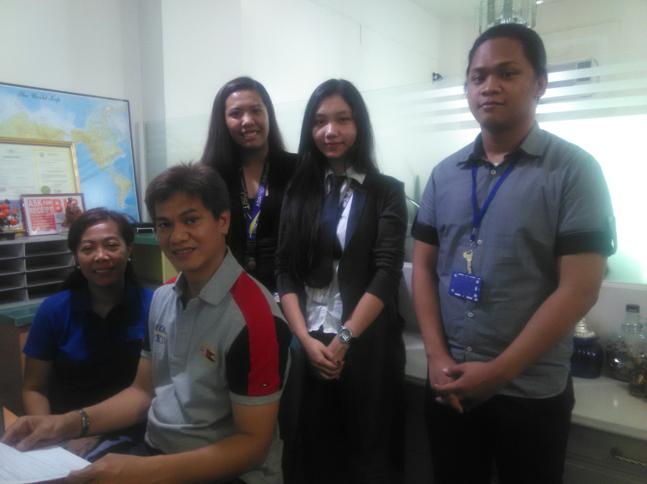

Slide 12
Member Contributions

Slide 13
Logronio

Slide 14
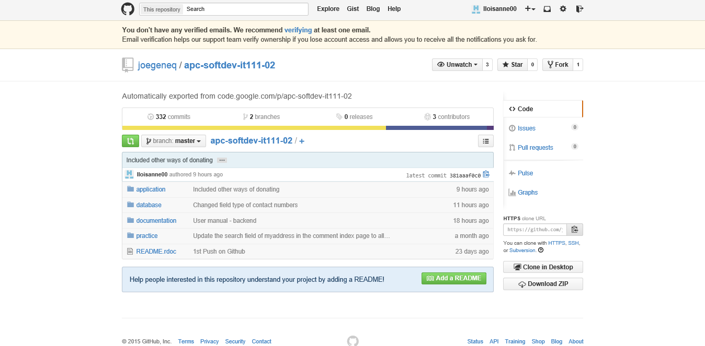

Slide 15
Mayo

Slide 17
Dadulla

Slide 19
Demo

Slide 20
Status of the Project

Slide 21
Next Steps to Take
Final presentation with the client
Scheduled next week Tuesday.
Recommended for Deployment

Slide 22
- Background of the project
- Review of the iterations / presentations with the client
- Present / Display the client feedback forms, meeting minutes, and picture with the client
- Brief outline of individual member contributions to the project.
- Show your Github project repository home page and charts of individual member contributions (most recent screenshot)
- Each Team member state your individual contribution to the application development.
- Each Team member show a screen shot of your most recent commits to your github project repository page.
- Each Team member show one commit with a diff between the previous and current version of the files.
- Demo of prototype on hosted server
- Current status of the project
- Percent completed
- Remaining work to be completed
- Client feedback regarding their interest in completing / implementing the project (or non-interest)
- Next steps to take
- Final presentation schedule with client
- Plans for continuing the project (if any).

